Slide 1





NEXT GEN EMPLOYABILITY PROGRAM
College Name: T John Institute of Technology
Team Name: Team_21
https://nextgen.edunetworld.com
nextgenep@edunetfoundation.org

Slide 2
CAPSTONE PROJECT SHOWCASE
Project title: ANALYSIS OF UNEMPLOYMENT IN INDIA USING POWER-BI
Problem Statement| Project Overview| Solution & Proposed Value Proposition | Wow Factor | Modelling & Results | Team Intro | Q&A
Notes:
Let me quickly walk you through the brief plan for today. We are going to discuss the need for this program, what it offers to the students, how it will help you choose a fine career pathway, how to get enrolled in this program and so on….

Slide 3


V
PROBLEM STATEMENT
The problem is to analyze the current state of unemployment in India using Power BI. Unemployment is a pressing issue that affects the economic well-being and social stability of a nation. Identifying key factors and visualizing the data through Power BI can provide valuable insights for policymakers, researchers, and stakeholders.
Notes:
We now request our technical expert Mr so and so to help you understand the finer details of the course and curriculum.

Slide 4

PROJECT OVERVIEW
This project utilizes Power BI to analyze India's unemployment situation using a provided dataset.
The project will involve the following key steps:
Data Collection and Integration
Data Cleaning and Preparation
Unemployment Metrics
Visualization
Spatial Analysis

Slide 5
SOLUTION
By utilizing Power BI's data visualization and analytics capabilities, this project offers a user-friendly and interactive platform to analyze and interpret complex unemployment data.
The solution includes the data-driven approach to understand the root causes, trends, and potential solutions related to unemployment in India
Proposed Value Proposition
The proposed solution aims to provide policymakers, researchers, and the general public with actionable insights, enabling them to make informed decisions and design targeted interventions to tackle unemployment effectively.

Slide 6
THE WOW in your solution
The wow factor of this project lies in its ability to transform Raw and Complex unemployment data into visually compelling and easy-to-understand visualizations.
Power BI's dynamic dashboards, interactive charts, and Reflexive user interface make the exploration and interpretation of complex data sets.
Moreover, the project's focus on analyzing unemployment from multiple angles and dimensions adds depth and richness to the insights.
Visually compelling and easy-to-understand visualizations.
Power BI's dynamic dashboards, interactive charts, and Reflexive user.
Analysis of unemployment from multiple angles and dimensions.
.

Slide 7
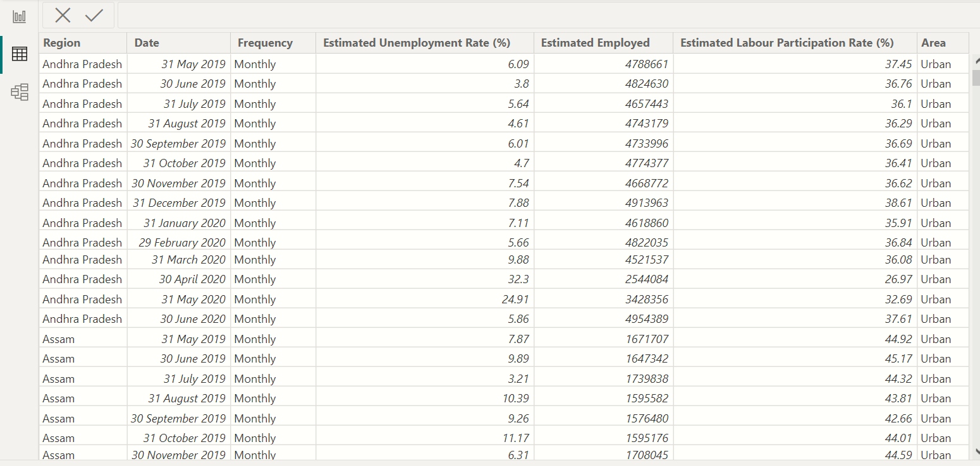
Modelling & results - Dataset

Slide 8
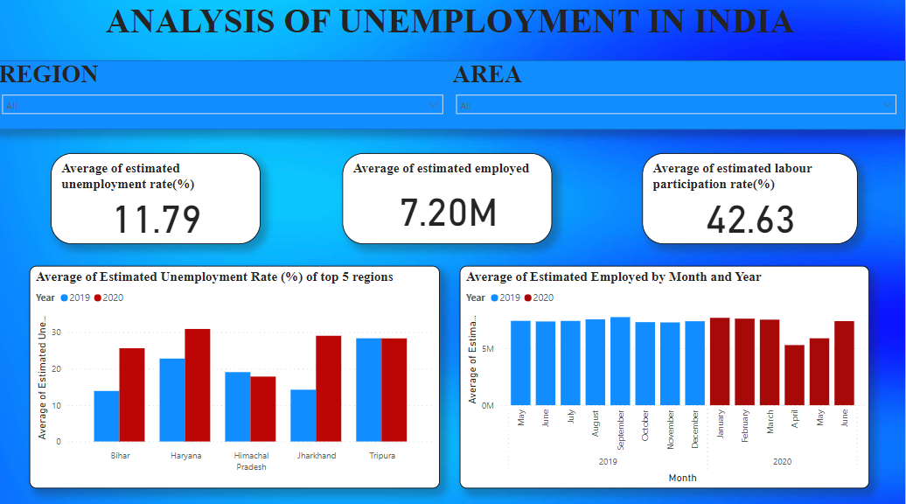
Modelling & results – Dashboard

Slide 9
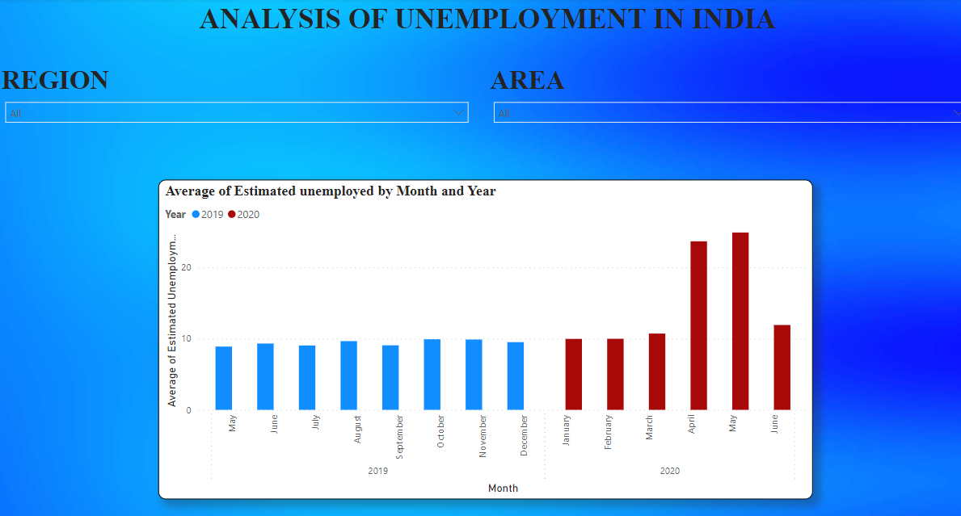
Modelling & results

Slide 10
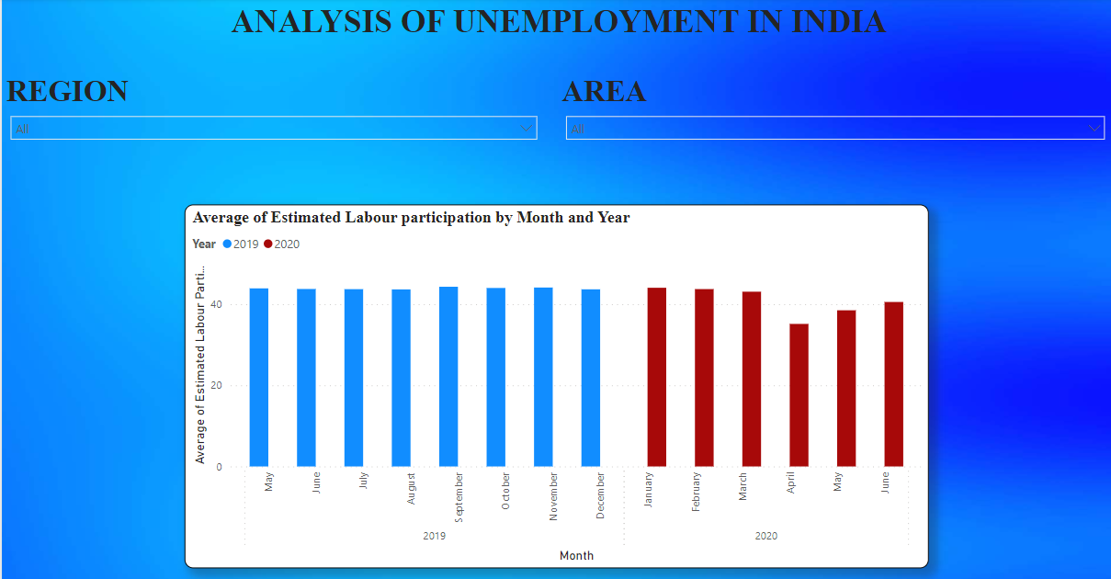
Modelling & results

Slide 11
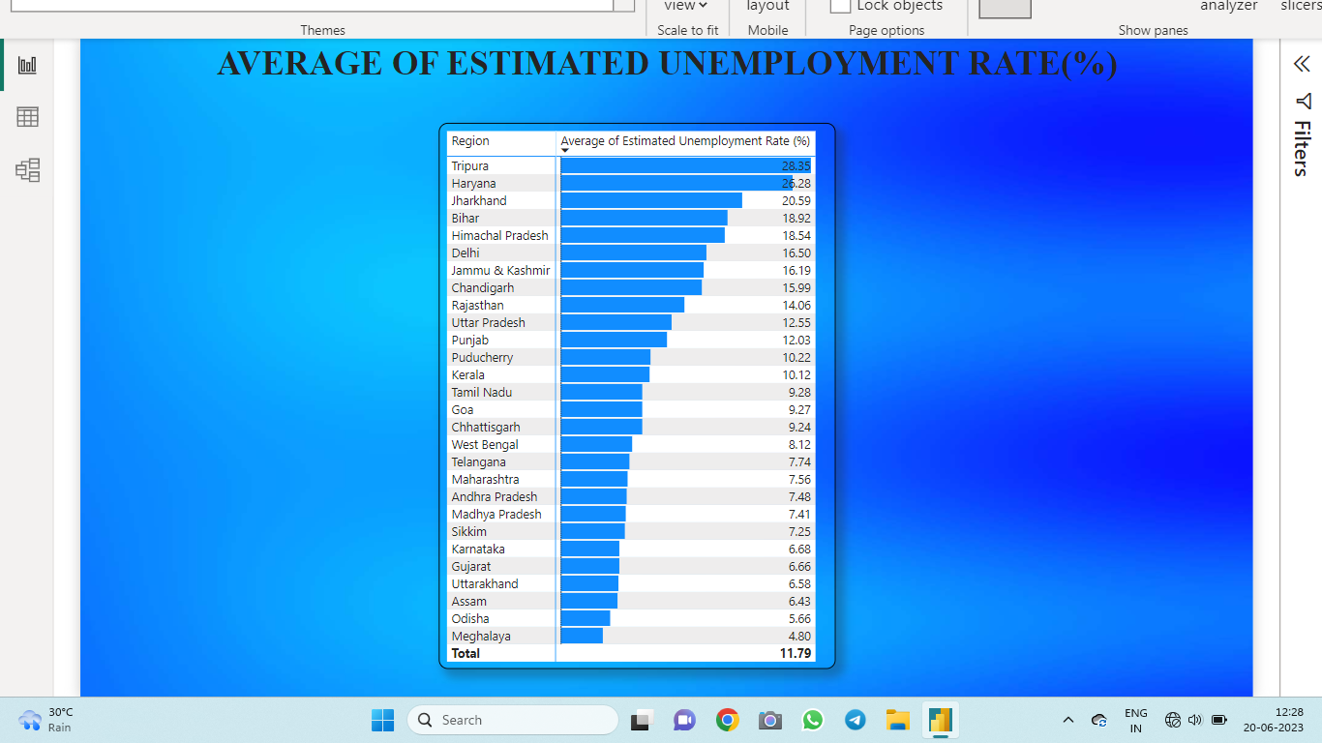
Modelling & results

Slide 12
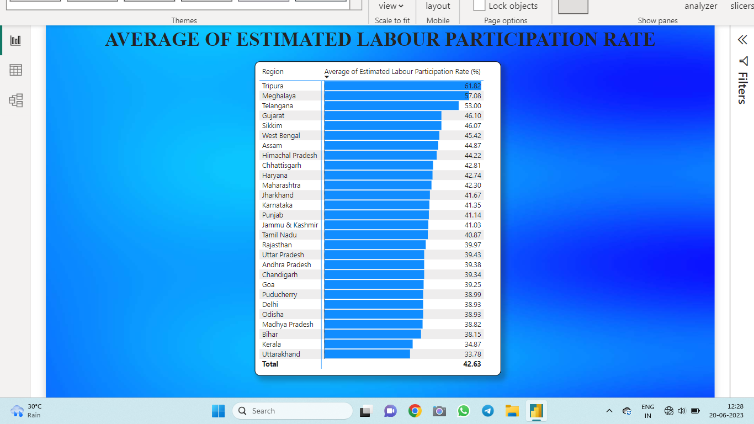
Modelling & results

Slide 13
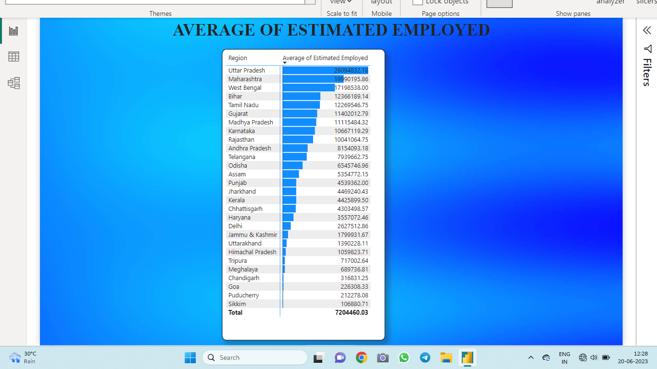
Modelling & results

Slide 14
Meet our team
VINODH KUMAR – Team Leader
AISHWARYA MS
DEEPAK
YASHASWINI
ZAIBA

Slide 15


Any
questions/comments?

Slide 16
THANK YOU

